Slide 1

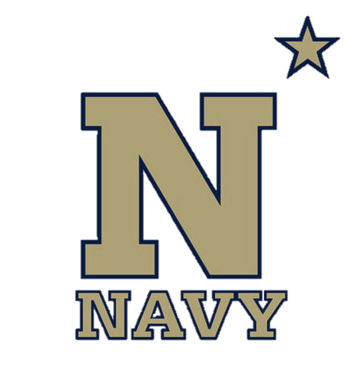
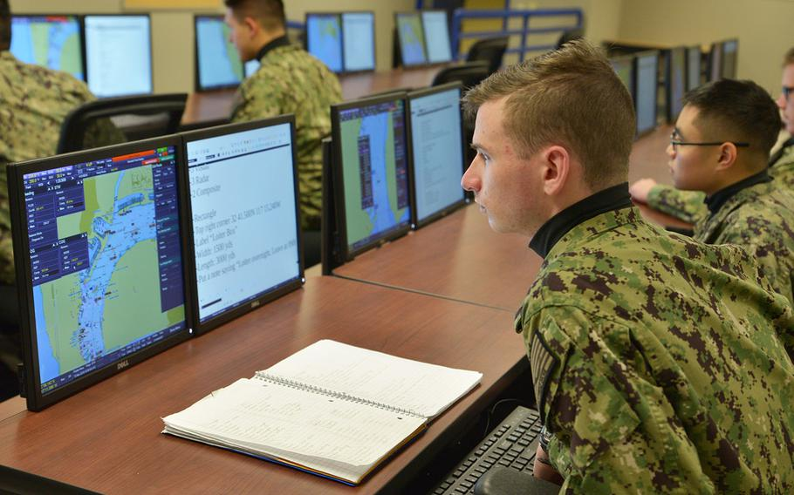
Introduction to Voyage Management System
NN220-09
SEANAV I United States Naval Academy
NN220 – Fundamentals of Navigation– Updated May 2023
Operations Officer I HMS PROTECTOR A173 I The Ice Patrol Ship

Slide 2
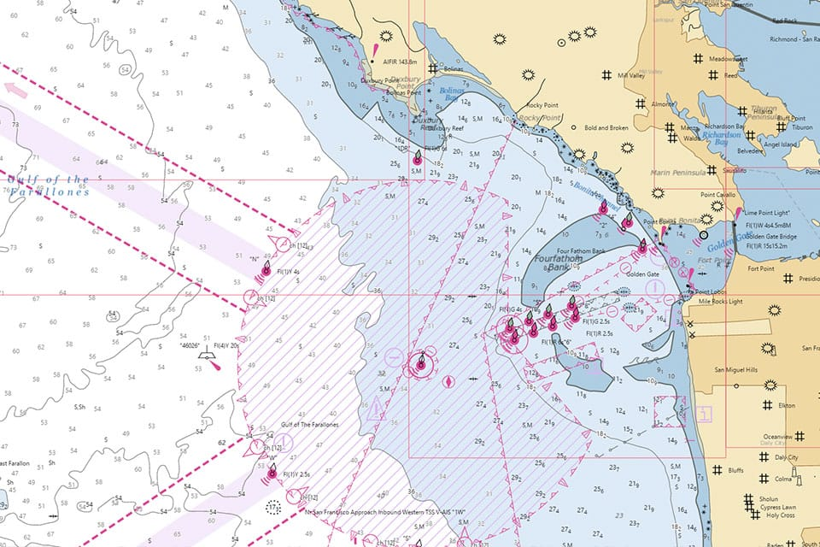
References
-The American Practical Navigator, Pub. No. 9, Bowditch, VOL. 1, 2019 Edition -Surface Ship Navigation Department Organizations and Regulations Manual (NAVDORM), COMNAVSURFPAC/COMNAVAIRPAC/COMNAVAIRLANT/COMNAVSURFLANT INSTRUCTION 3530.4 series -VMS Operator’s Manual (avalable electronically within the VMS Help Menu)
SEANAV I United States Naval Academy
NN220 – Fundamentals of Navigation
Operations Officer I HMS PROTECTOR A173 I The Ice Patrol Ship

Slide 3
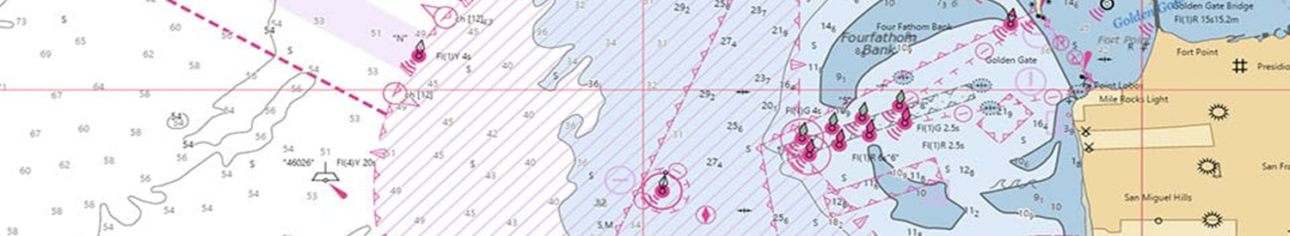
Enabling Objectives
1 - UNDERSTAND the Display and Basic Functions of VMS. a. Sensors data and display (SOG, STW, HDG, COG, MOB etc.) 2 - UNDERSTAND the sensor sources and identify valid and invalid sensors. 3 - UNDERSTAND all toolbars and Main Menu options. 4 - UNDERSTAND and set up all Feature Settings IAW SEANAV Navigation Standards. 5 - USE GoTo to move to different locations on VMS. 6 - IDENTIFY and load a chart, and understand chart scales. 7 - UNDERSTAND anchoring procedures and considerations. 8 - UNDERSTAND Critical Points, how to input them, and when they should be utilized. 9 - IDENTIFY Chart categories used in VMS and know how to read a DNC name. 10 - OPERATE Various Navigation Tools. a. Perform Man-Overboard Procedures b. Lines of Position c. Anchoring
SEANAV I United States Naval Academy
NN220 – Fundamentals of Navigation
Operations Officer I HMS PROTECTOR A173 I The Ice Patrol Ship

Slide 4
Enabling Objectives
11 - OPERATE appropriate settings in the Safety Configuration Menu. 12 - USE Query Chart function. 13 - USE chart menu to create a new layer. 14 - ESTABLISH visual and RADAR NAVAIDS by creating a Layer under Manual Chart Update. 15 - USE the Route Editor to create, and save a Route Plan/NAV Plan. Enter Critical Points to coincide with Required Actions/Reports 16 - MAKE chart corrections to a digital nautical chart (DNC). 17 - EXPLAIN & Identify the Cross Track Error. 18 - LOAD a Route Plan. 19 - CREATE, save, load, start, stop and clear a Navigation Plan. 20 - UNDERSTAND the functions of Route Monitoring.
SEANAV I United States Naval Academy
NN220 – Fundamentals of Navigation
Operations Officer I HMS PROTECTOR A173 I The Ice Patrol Ship

Slide 5
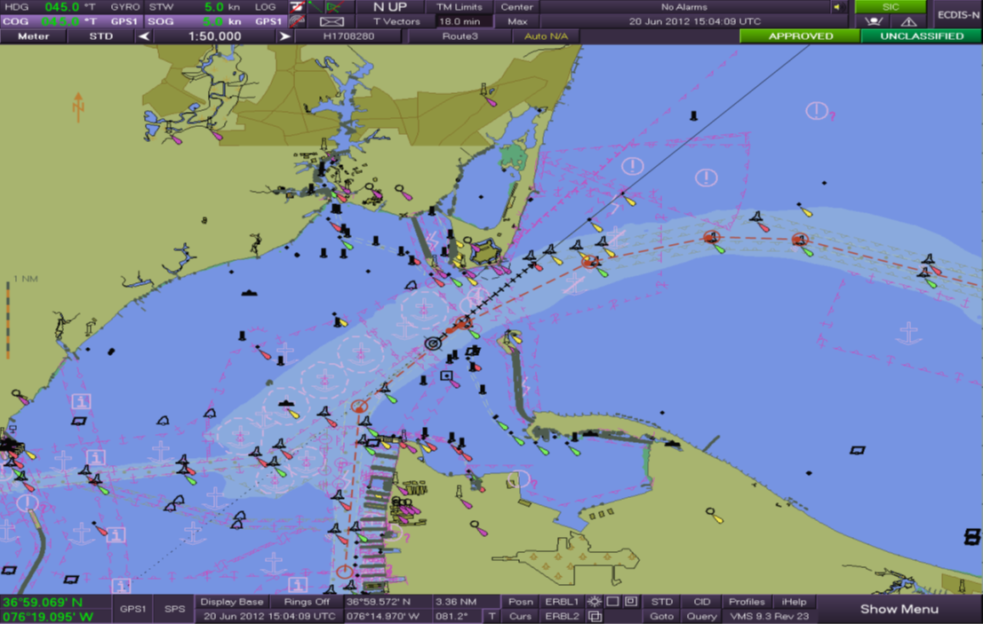
VMS Main Display
SEANAV I United States Naval Academy
NN220 – Fundamentals of Navigation
Operations Officer I HMS PROTECTOR A173 I The Ice Patrol Ship

Slide 6
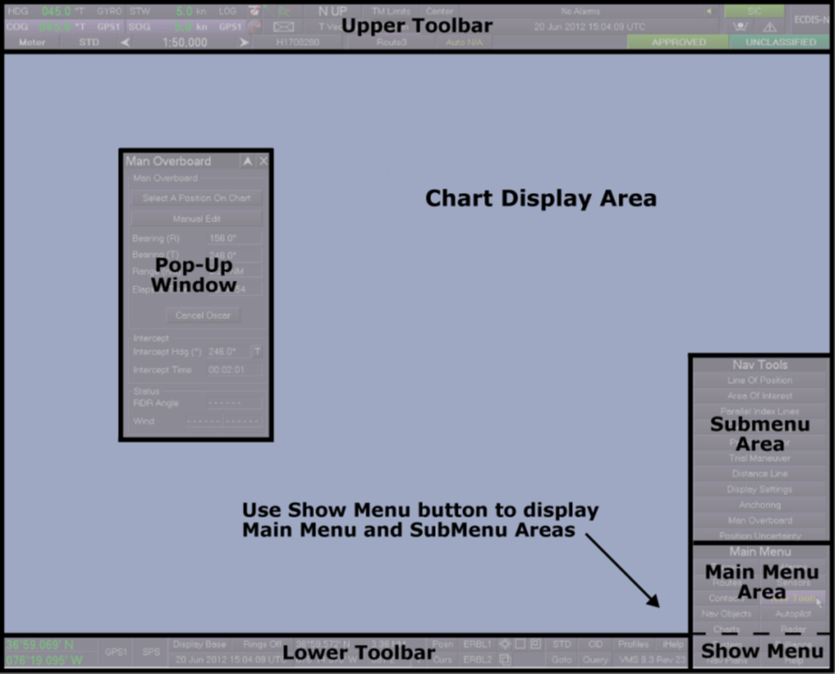
VMS Main Display
SEANAV I United States Naval Academy
NN220 – Fundamentals of Navigation
Operations Officer I HMS PROTECTOR A173 I The Ice Patrol Ship

Slide 7
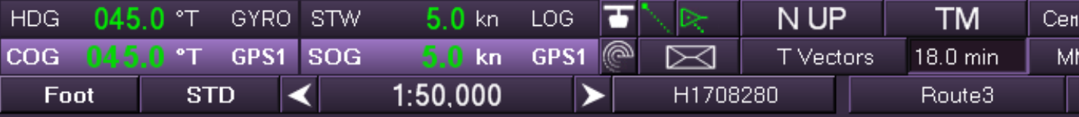
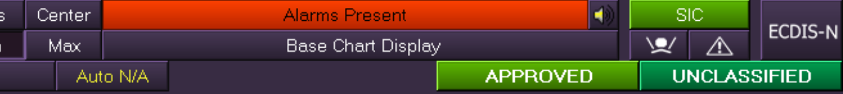
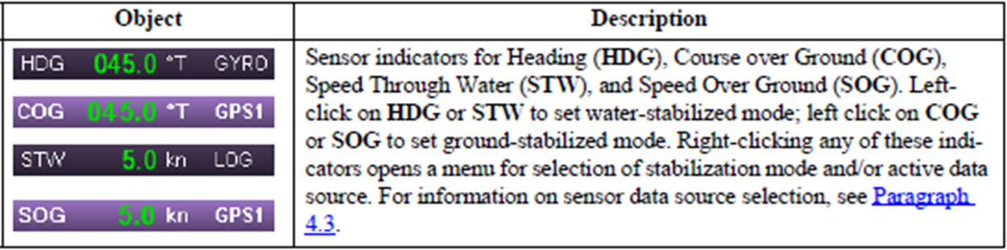
VMS Upper Toolbar
SEANAV I United States Naval Academy
NN220 – Fundamentals of Navigation
Operations Officer I HMS PROTECTOR A173 I The Ice Patrol Ship

Slide 8
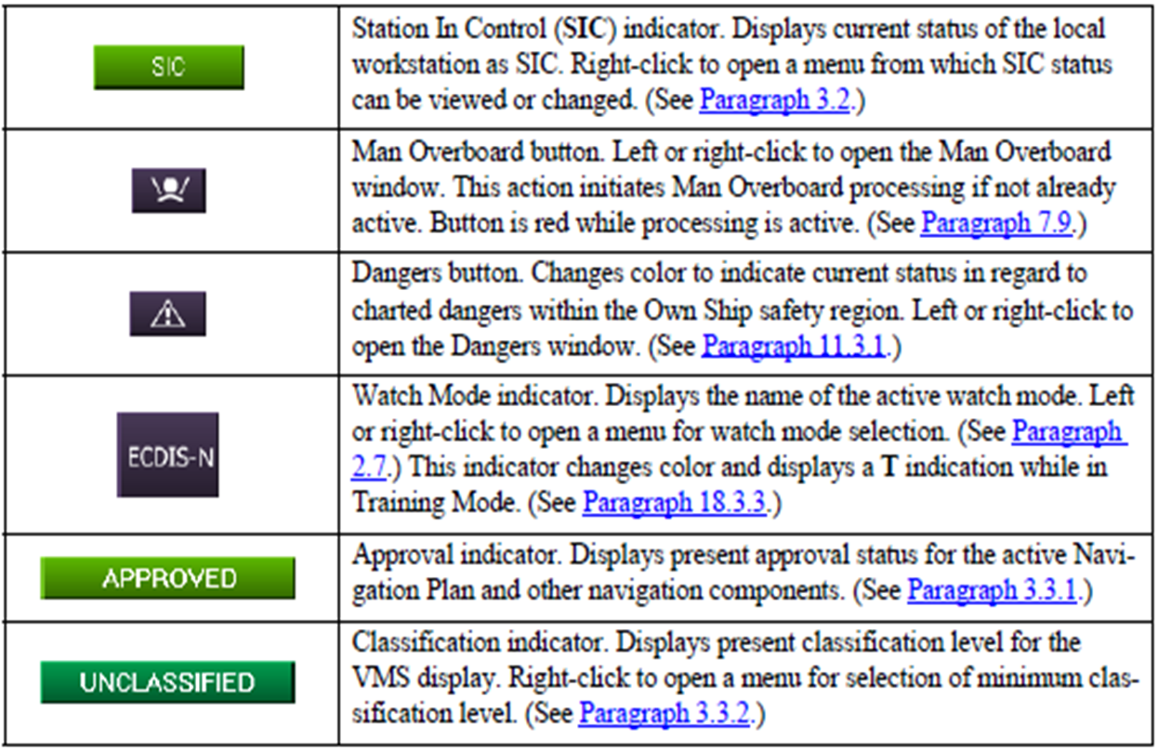
VMS Upper Toolbar
SEANAV I United States Naval Academy
NN220 – Fundamentals of Navigation
Operations Officer I HMS PROTECTOR A173 I The Ice Patrol Ship

Slide 9
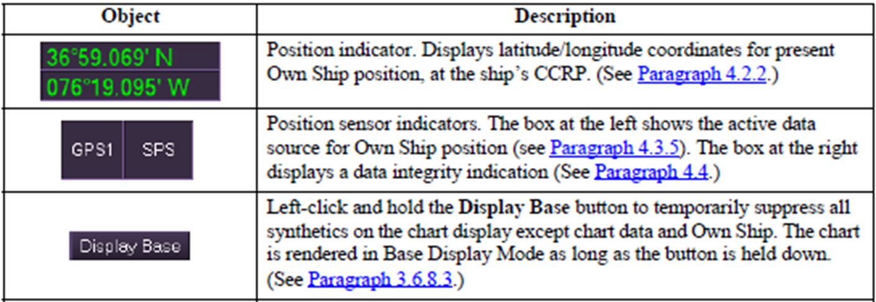
VMS Lower Toolbar
SEANAV I United States Naval Academy
NN220 – Fundamentals of Navigation
Operations Officer I HMS PROTECTOR A173 I The Ice Patrol Ship

Slide 10
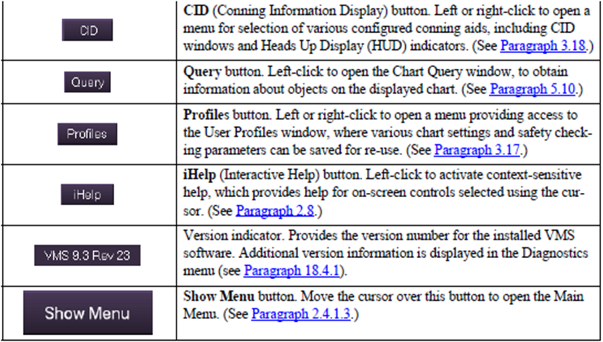
VMS Lower Toolbar
SEANAV I United States Naval Academy
NN220 – Fundamentals of Navigation
Operations Officer I HMS PROTECTOR A173 I The Ice Patrol Ship

Slide 11
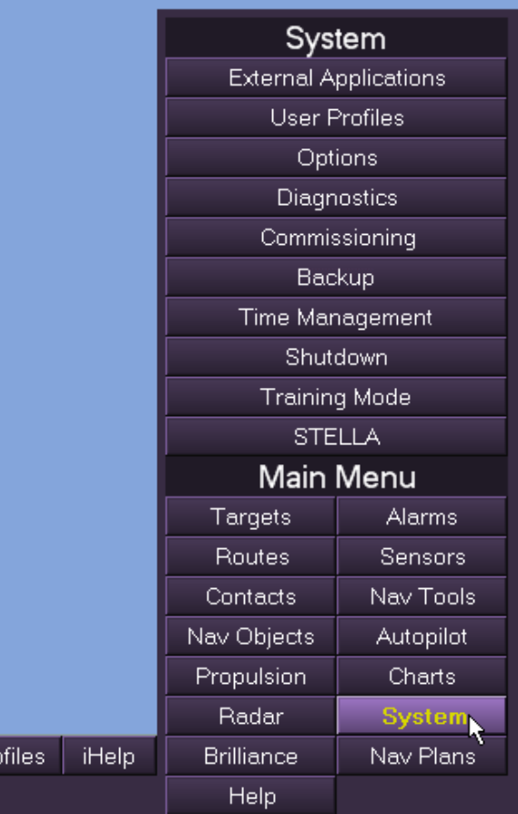
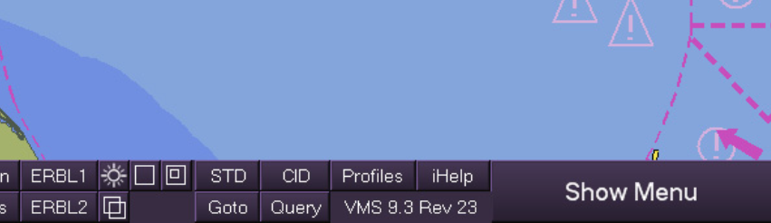
VMS Main Menu and SubMenu
Hovering the mouse over “Show Menu” will bring up the “Main Menu”
Selecting any item in the “Main Menu” will bring up that item’s “Submenu”
SEANAV I United States Naval Academy
NN220 – Fundamentals of Navigation
Operations Officer I HMS PROTECTOR A173 I The Ice Patrol Ship

Slide 12
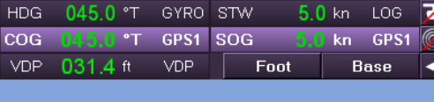
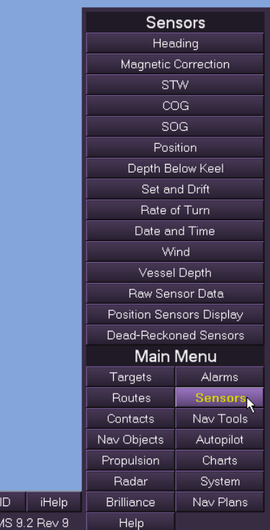
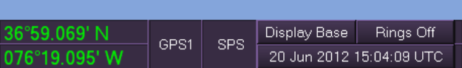
VMS Sensor Information
Primary Sensor Information
Heading, Course Over Ground, Speed Through the Water, Speed Over Ground, Vessel Depth, and Position
When active, these sensors should appear green with selected sensor indicated on the right.
Sensor Submenu
Can view/change the source of information for specific sensors.
Can also view sensor source by clicking on the sensor information on the upper and lower toolbars.
Valid Sensors: GREEN
Degraded Sensors: YELLOW
Invalid Sensors: RED
SEANAV I United States Naval Academy
NN220 – Fundamentals of Navigation
Operations Officer I HMS PROTECTOR A173 I The Ice Patrol Ship

Slide 13
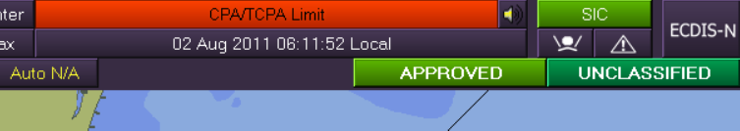
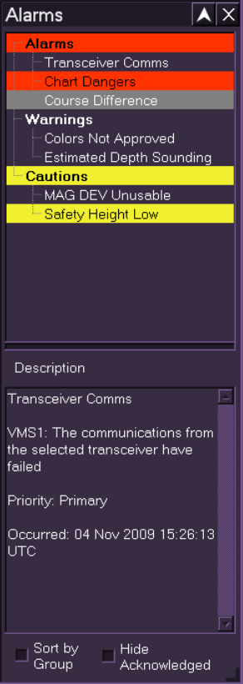
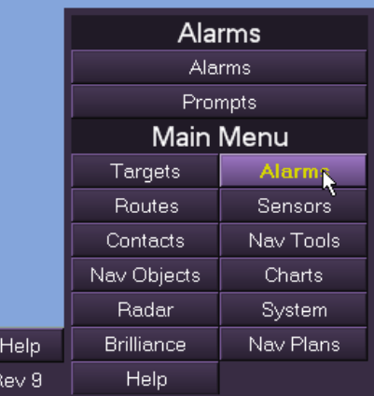
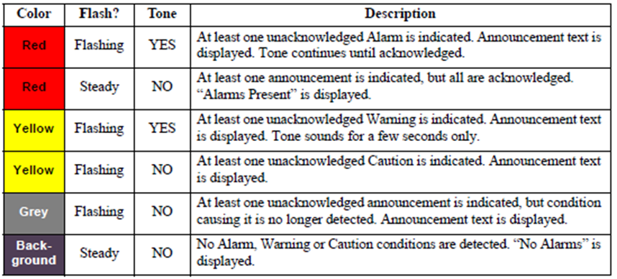
VMS Alarm Announcements
3 Categories
Alarms
Warnings
Cautions
Accesses in upper toolbar or alarm submenu
SEANAV I United States Naval Academy
NN220 – Fundamentals of Navigation
Operations Officer I HMS PROTECTOR A173 I The Ice Patrol Ship

Slide 14
VMS Alarm Announcements
3 Categories
Alarms
Warnings
Cautions
Accesses in upper toolbar or alarm submenu
SEANAV I United States Naval Academy
NN220 – Fundamentals of Navigation
Operations Officer I HMS PROTECTOR A173 I The Ice Patrol Ship

Slide 15
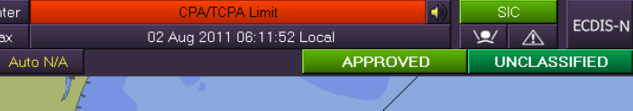
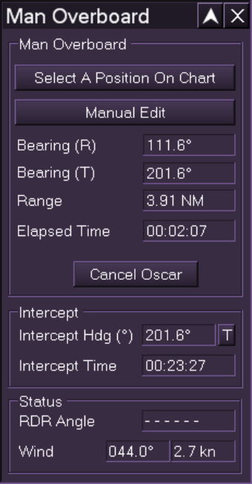

VMS Man Overboard
To enter a man overboard, select the “Man Overboard” icon on the upper toolbar.
The MOB icon will be orange while the man overboard is active:
The “Man Overboard” pop-up window will provide necessary information for recovery and can be manually adjusted.
VMS automatically solves for Set and Drive to aid in recovery.
SEANAV I United States Naval Academy
NN220 – Fundamentals of Navigation
Operations Officer I HMS PROTECTOR A173 I The Ice Patrol Ship

Slide 16
VMS Navigation Plans
We use the many functions of VMS to aid in voyage planning
Our ultimate goal is to create a Navigation Plan in the system for watch-standers to follow on the bridge.
A Nav Plan in VMS has three primary components:
Charts (what area we are operating in)
Layer (customization of the area)
Route (how we will travel through the area)
SEANAV I United States Naval Academy
NN220 – Fundamentals of Navigation
Operations Officer I HMS PROTECTOR A173 I The Ice Patrol Ship

Slide 17
Developing a NAV Plan
Set Chart Settings, Dangers and Safety Parameters
Center chart display on the area you will be operating
Record required DNCs (charts) for route
Create a Layer (customize the area)
NTM updates if cannot be applied through a VDU
Navigation Aids to be used for Visual/RADAR LOPs
Create a Route
ETA/ETD
Critical Points
Create an Anchorage (if applicable)
Create a Navigation Plan
SEANAV I United States Naval Academy
NN220 – Fundamentals of Navigation
Operations Officer I HMS PROTECTOR A173 I The Ice Patrol Ship

Slide 18
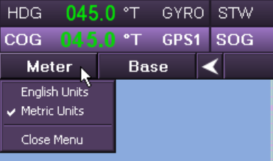

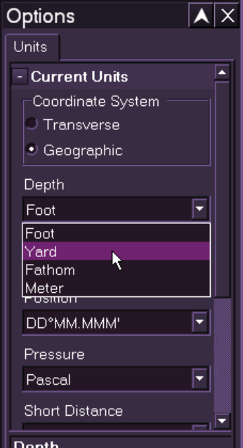
Units of Measure
While preparing our chart, we want to ensure our information aligns with our display.
Units of measure can be changed by selecting “Options” in the “System” submenu.
Our default unit for “Depth” and “Height” is “Foot”
Our default unit for “Position” is DD°MM’SS”
The “Foot/Meter” button on the upper toolbar allows us to display either English or Metric Units
Our default is “English Units”
SEANAV I United States Naval Academy
NN220 – Fundamentals of Navigation
Operations Officer I HMS PROTECTOR A173 I The Ice Patrol Ship

Slide 19
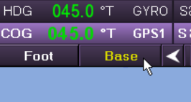
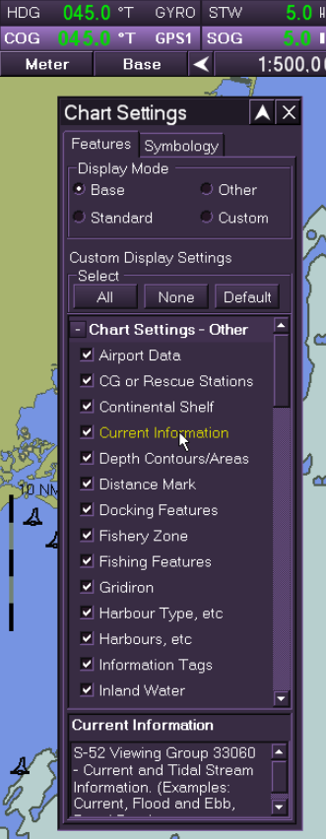
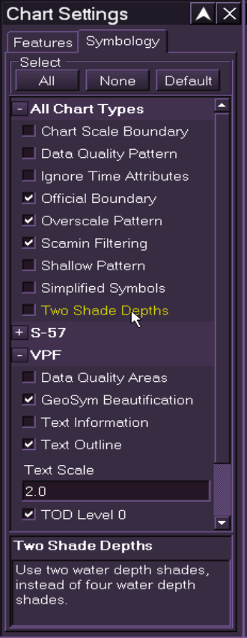
Chart Settings
We alter our Chart Settings by selecting the “Base/STD/Other/Custom” button on the upper toolbar. Chart Settings are divided under two tabs: “Features” and “Symbology”
Our default display mode under “Features” is “Custom”
Our default “Custom Display Setting” is “All”
Our default “Symbology” is “All”
Our Default “Text Scale” is “1.0”
SEANAV I United States Naval Academy
NN220 – Fundamentals of Navigation
Operations Officer I HMS PROTECTOR A173 I The Ice Patrol Ship

Slide 20
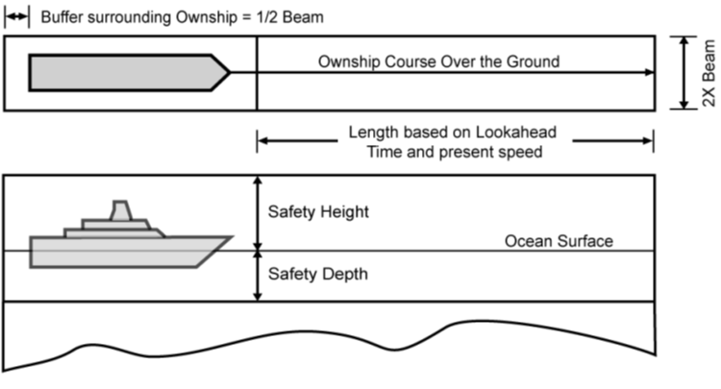
Safety Parameters
In order to avoid groundings and collisions, we develop a 3-D Box which moves with the ship called “Own Ship Safety Region.”
The Box extends ahead of the Ship to a distance determined by Speed and “Look Ahead Time”.
The values require to be input to create this region are:
Look-Ahead Time (similar to DR)
Added Breadth
Safety Depth
Safety Height.
VMS alarm if our course crosses a danger that falls within set parameters.
SEANAV I United States Naval Academy
NN220 – Fundamentals of Navigation
Operations Officer I HMS PROTECTOR A173 I The Ice Patrol Ship

Slide 21
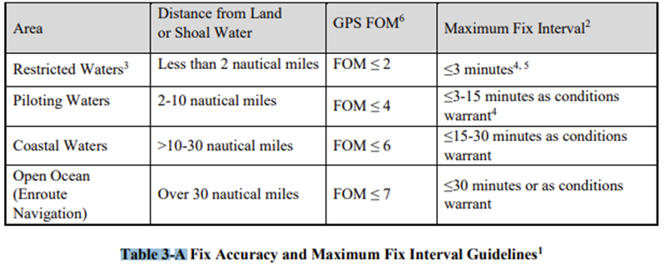
Own Ship Safety Region
Look-ahead time
As prescribed in NAVDORM
2x Fix Interval
Added Breadth
Ship’s beam width
Safety Depth
Equal to Navigational Draft specified in Ship’s characteristics
Usually Ship’s maximum draft plus 10% or as ordered by CO for safety
Detailed in Ship’s NAVBILL
Safety Height
Height of Mast + (as per common practice) 25 feet
Applies to all Ships regardless of class.
Alarm on Cautions
“ON”
SEANAV I United States Naval Academy
NN220 – Fundamentals of Navigation
Operations Officer I HMS PROTECTOR A173 I The Ice Patrol Ship

Slide 22
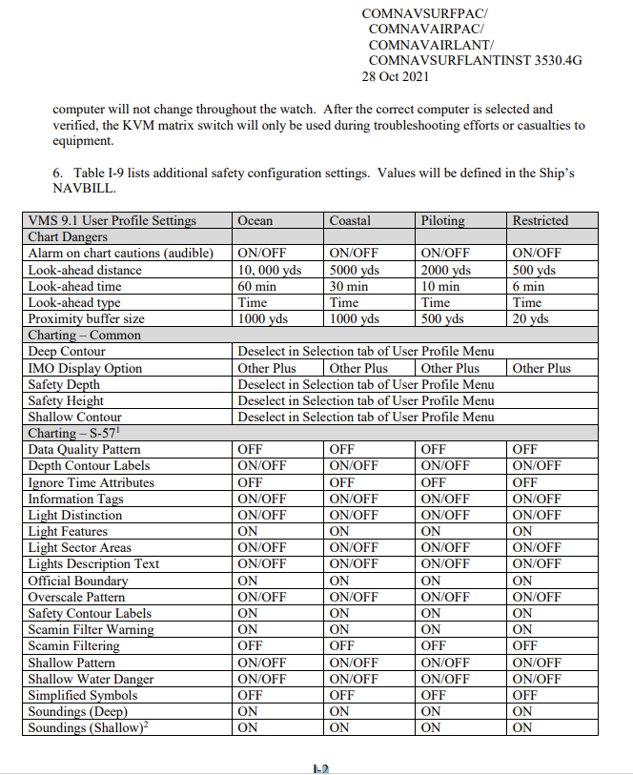
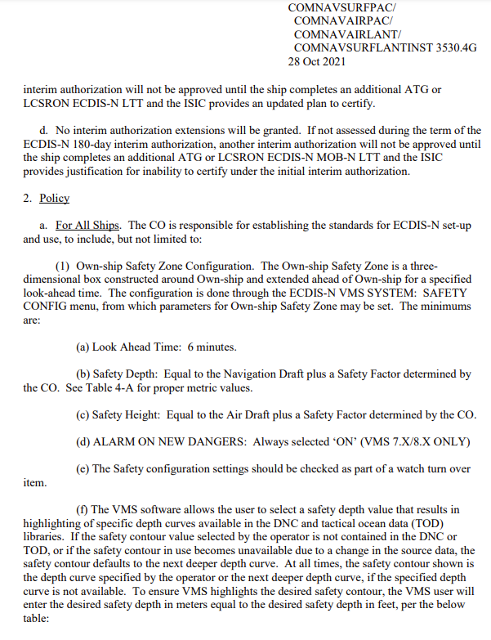
NAVDORM Settings

Slide 23
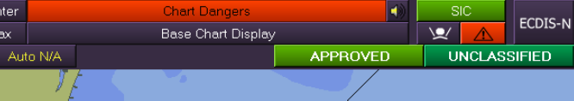
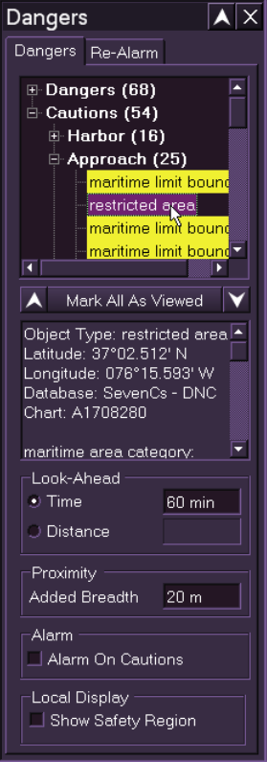
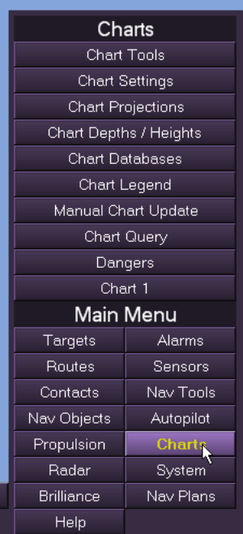

Own Ship Safety Region
Safety region values are entered in two areas: “Dangers” and “Chart Depths/ Heights”
Both pop-up windows are accessed in the “Charts” submenu.
The “Dangers” pop-up window can also be accessed on the upper toolbar.
SEANAV I United States Naval Academy
NN220 – Fundamentals of Navigation
Operations Officer I HMS PROTECTOR A173 I The Ice Patrol Ship

Slide 24
Example
Ship’s Characteristics
Draft: 31 feet
Navigation Draft: 36 feet
Height of Mast: 160 feet
Beam Width: 55 feet
Height of Eye: 60 feet
Ship Length: 567 feet
= Safety Depth
+ 25 feet = Safety Height
= Added Breadth
SEANAV I United States Naval Academy
NN220 – Fundamentals of Navigation
Operations Officer I HMS PROTECTOR A173 I The Ice Patrol Ship

Slide 25
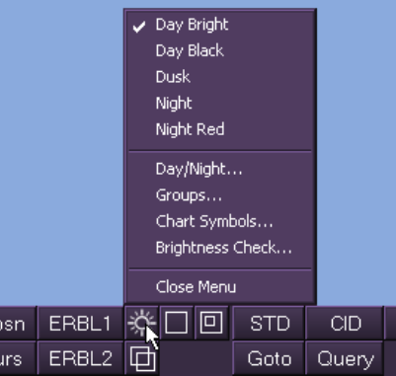
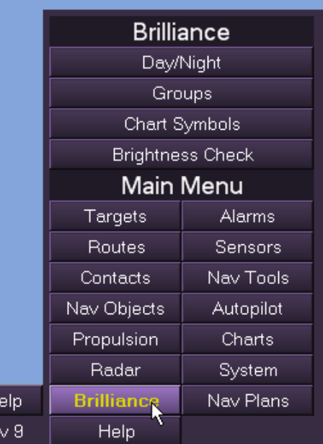
Brilliance
We are able to adjust the VMS display’s brilliance for different lighting conditions.
We can access our brilliance options by selecting the brilliance icon on the lower toolbar or through the brilliance sub-menu.
SEANAV I United States Naval Academy
NN220 – Fundamentals of Navigation
Operations Officer I HMS PROTECTOR A173 I The Ice Patrol Ship

Slide 26
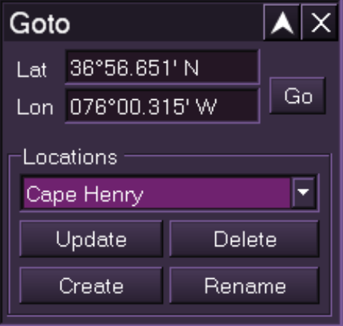
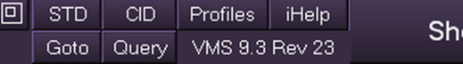
We can offset the chart left, right, up, or down by clicking near the edge of the chart display (the cursor will change into an arrow).
To center the chart on a specific position, select “Goto” on the lower toolbar to open the “Goto” pop-up window.
Enter desired latitude and longitude and select “Go” to offset the chart display on the position.
Enter the following coordinates:
Lat: 32°40’000” N
Lon: 117°14’000”W
What area is your chart now centered on?
Moving the Chart Display
We can offset the chart left, right, up, or down by clicking near the edge of the chart display (the cursor will change into an arrow).
To center the chart on a specific position, select “Goto” on the lower toolbar to open the “Goto” pop-up window.
Enter desired latitude and longitude and select “Go” to offset the chart display on the position.
Enter the following coordinates:
Lat: 32°40’000” N
Lon: 117°14’000”W
What area is your chart now centered on?
SEANAV I United States Naval Academy
NN220 – Fundamentals of Navigation
Operations Officer I HMS PROTECTOR A173 I The Ice Patrol Ship

Slide 27
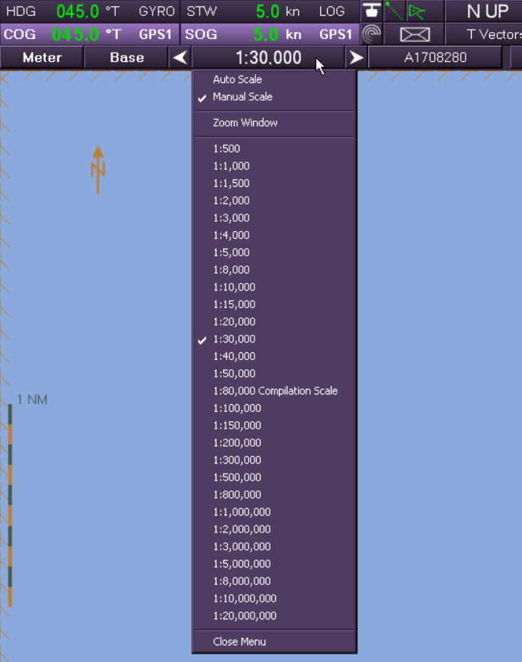
We can offset the chart left, right, up, or down by clicking near the edge of the chart display (the cursor will change into an arrow).
To center the chart on a specific position, select “Goto” on the lower toolbar to open the “Goto” pop-up window.
Enter desired latitude and longitude and select “Go” to offset the chart display on the position.
Enter the following coordinates:
Lat: 32°40’000” N
Lon: 117°14’000”W
What area is your chart now centered on?
Chart Display Scale
We can manually adjust the chart display scale on the upper toolbar.
Using the directional arrows on either side of the current scale will adjust the displayed scale.
Clicking on the current scale will display the chart scale drop-down menu, and we can select the desired scale.
We can also zoom on a specific area by right clicking on the display and selecting “Zoom Here.”
A dotted, adjustable box will appear around the desired area.
SEANAV I United States Naval Academy
NN220 – Fundamentals of Navigation
Operations Officer I HMS PROTECTOR A173 I The Ice Patrol Ship

Slide 28
We can offset the chart left, right, up, or down by clicking near the edge of the chart display (the cursor will change into an arrow).
To center the chart on a specific position, select “Goto” on the lower toolbar to open the “Goto” pop-up window.
Enter desired latitude and longitude and select “Go” to offset the chart display on the position.
Enter the following coordinates:
Lat: 32°40’000” N
Lon: 117°14’000”W
What area is your chart now centered on?
Charts in VMS
To access the available chart database, select the “Charts drop-down menu” on the upper toolbar.
The Navy uses DNCs, so ensure you have the appropriate chart(s) selected.
There are four categories of DNCs based on chart scale:
General (small scale, large area)
Coastal
Approach
Harbor (large scale, small area)
SEANAV I United States Naval Academy
NN220 – Fundamentals of Navigation
Operations Officer I HMS PROTECTOR A173 I The Ice Patrol Ship

Slide 29
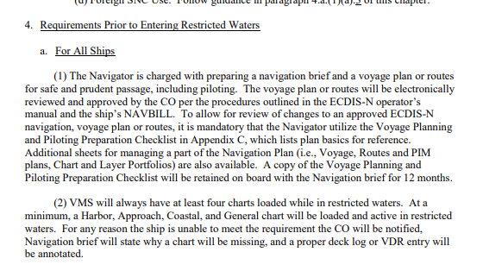
We can offset the chart left, right, up, or down by clicking near the edge of the chart display (the cursor will change into an arrow).
To center the chart on a specific position, select “Goto” on the lower toolbar to open the “Goto” pop-up window.
Enter desired latitude and longitude and select “Go” to offset the chart display on the position.
Enter the following coordinates:
Lat: 32°40’000” N
Lon: 117°14’000”W
What area is your chart now centered on?
Charts in VMS
SEANAV I United States Naval Academy
NN220 – Fundamentals of Navigation
Operations Officer I HMS PROTECTOR A173 I The Ice Patrol Ship

Slide 30
We can offset the chart left, right, up, or down by clicking near the edge of the chart display (the cursor will change into an arrow).
To center the chart on a specific position, select “Goto” on the lower toolbar to open the “Goto” pop-up window.
Enter desired latitude and longitude and select “Go” to offset the chart display on the position.
Enter the following coordinates:
Lat: 32°40’000” N
Lon: 117°14’000”W
What area is your chart now centered on?
Required Charts
Once your display is centered on the desired area, the “Charts drop-down menu” will list all the available charts.
Ex: San Diego Harbor (32-40N; 117-14W)
DNCs Required:
Harbor → H___________
Approach → A___________
Coastal → COA_________
General → GEN_________
1316010
1316010
13B
13A
SEANAV I United States Naval Academy
NN220 – Fundamentals of Navigation
Operations Officer I HMS PROTECTOR A173 I The Ice Patrol Ship

Slide 31
We can offset the chart left, right, up, or down by clicking near the edge of the chart display (the cursor will change into an arrow).
To center the chart on a specific position, select “Goto” on the lower toolbar to open the “Goto” pop-up window.
Enter desired latitude and longitude and select “Go” to offset the chart display on the position.
Enter the following coordinates:
Lat: 32°40’000” N
Lon: 117°14’000”W
What area is your chart now centered on?
How to Read a DNC
How to read a DNC: H1316010
H: Scale (Harbor)
Could be Harbor (H), Approach (A), Coastal (COA), or General (GEN)
13: DNC Region (13 of 29 DNC regions)
Could be any region from 01-29, see DNC regional map
16010: World Port Index (WPI) Number
Affiliated to a specific port
Can search any WPI here
http://msi.nga.mil/NGAPortal/MSI.portal?_nfpb=true&_pageLabel=msi_portal_page_62&pubCode=0015
SEANAV I United States Naval Academy
NN220 – Fundamentals of Navigation
Operations Officer I HMS PROTECTOR A173 I The Ice Patrol Ship

Slide 32
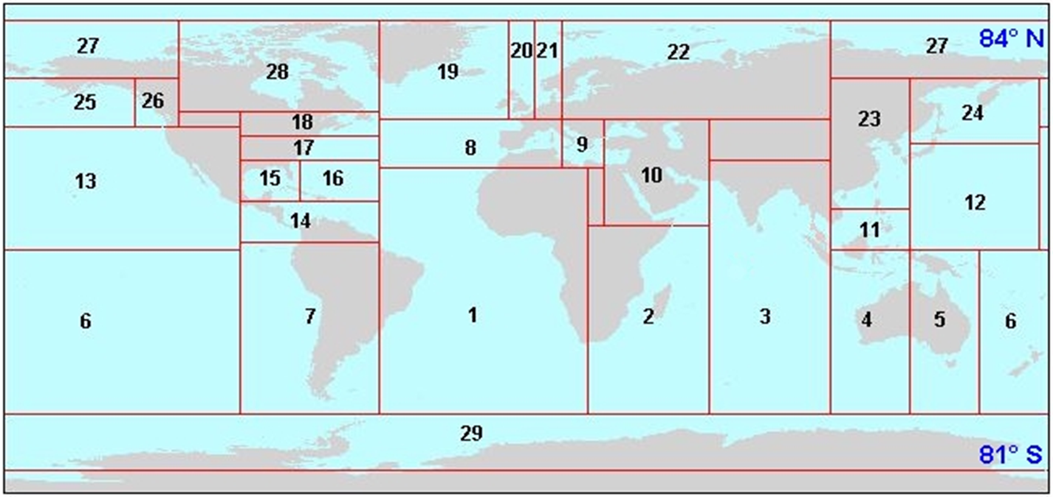
We can offset the chart left, right, up, or down by clicking near the edge of the chart display (the cursor will change into an arrow).
To center the chart on a specific position, select “Goto” on the lower toolbar to open the “Goto” pop-up window.
Enter desired latitude and longitude and select “Go” to offset the chart display on the position.
Enter the following coordinates:
Lat: 32°40’000” N
Lon: 117°14’000”W
What area is your chart now centered on?
DNC Regions
SEANAV I United States Naval Academy
NN220 – Fundamentals of Navigation
Operations Officer I HMS PROTECTOR A173 I The Ice Patrol Ship

Slide 33
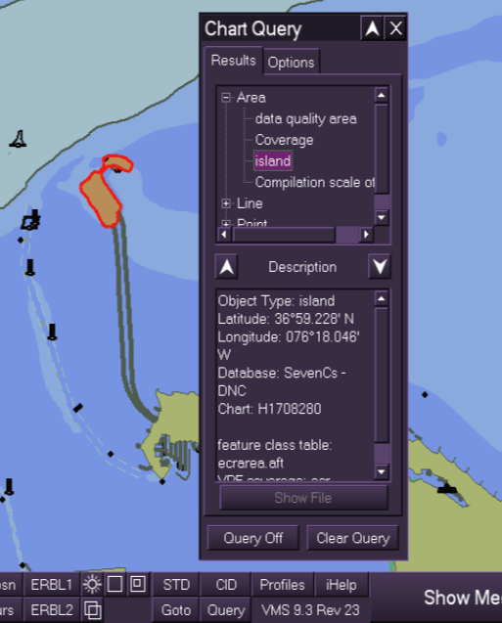
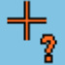
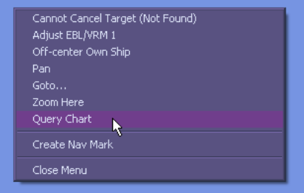

We can offset the chart left, right, up, or down by clicking near the edge of the chart display (the cursor will change into an arrow).
To center the chart on a specific position, select “Goto” on the lower toolbar to open the “Goto” pop-up window.
Enter desired latitude and longitude and select “Go” to offset the chart display on the position.
Enter the following coordinates:
Lat: 32°40’000” N
Lon: 117°14’000”W
What area is your chart now centered on?
Chart Query
For information about individual objects on a chart display, we conduct a “Chart Query.”
Selecting the “Query” button on the Lower Toolbar opens the “Chart Query” pop-up window
Click the “Query Off” button to activate the query. The Cursor will change to the query shape and the label will change to “Query On.”
We can conduct a query directly on the display by right clicking the area we wish to query and selecting “Query Chart.”
SEANAV I United States Naval Academy
NN220 – Fundamentals of Navigation
Operations Officer I HMS PROTECTOR A173 I The Ice Patrol Ship

Slide 34
We can offset the chart left, right, up, or down by clicking near the edge of the chart display (the cursor will change into an arrow).
To center the chart on a specific position, select “Goto” on the lower toolbar to open the “Goto” pop-up window.
Enter desired latitude and longitude and select “Go” to offset the chart display on the position.
Enter the following coordinates:
Lat: 32°40’000” N
Lon: 117°14’000”W
What area is your chart now centered on?
Developing a NAV Plan
Set Chart Settings, Dangers and Safety Parameters
Center chart display on the area you will be operating
Record required DNCs (charts) for route
Create a Layer (customize the area)
NTM
Navigation Aids
Create a Route
ETA/ETD
Critical Points
Create an Anchorage
Create a Navigation Plan
SEANAV I United States Naval Academy
NN220 – Fundamentals of Navigation
Operations Officer I HMS PROTECTOR A173 I The Ice Patrol Ship

Slide 35
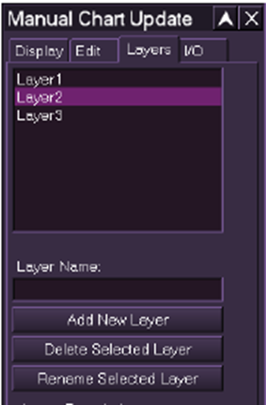
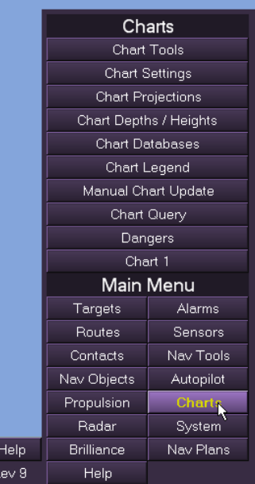
We can offset the chart left, right, up, or down by clicking near the edge of the chart display (the cursor will change into an arrow).
To center the chart on a specific position, select “Goto” on the lower toolbar to open the “Goto” pop-up window.
Enter desired latitude and longitude and select “Go” to offset the chart display on the position.
Enter the following coordinates:
Lat: 32°40’000” N
Lon: 117°14’000”W
What area is your chart now centered on?
Create a Layer
We create a layer to customize our display for specific evolutions or in a response to an update.
Examples of what we include in a Layer include:
Navigation Aids
Notice to Mariners (NTM)
To create a new Layer:
“Show Menu” → “Charts” → “Manual Chart Update”
In the pop-up window, select the “Layers” tab
Type in desired layer name and select “Add New Layer”
Create a Layer and name it “NN220x_Last Name”
SEANAV I United States Naval Academy
NN220 – Fundamentals of Navigation
Operations Officer I HMS PROTECTOR A173 I The Ice Patrol Ship

Slide 36
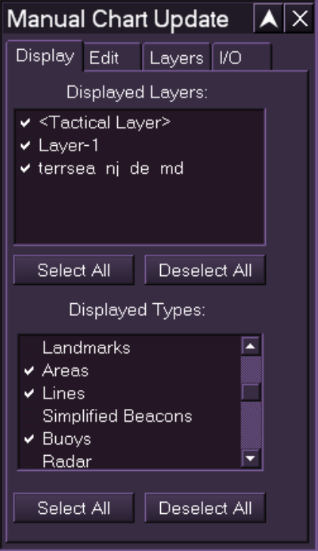
We can offset the chart left, right, up, or down by clicking near the edge of the chart display (the cursor will change into an arrow).
To center the chart on a specific position, select “Goto” on the lower toolbar to open the “Goto” pop-up window.
Enter desired latitude and longitude and select “Go” to offset the chart display on the position.
Enter the following coordinates:
Lat: 32°40’000” N
Lon: 117°14’000”W
What area is your chart now centered on?
Manual Chart Updates
To ensure your layer is the only one on your display, select the “Display” tab and the Displayed Layers are shown.
Click a layer from the list to select/ deselect the layer.
Layers with a check mark will be visible on your display.
SEANAV I United States Naval Academy
NN220 – Fundamentals of Navigation
Operations Officer I HMS PROTECTOR A173 I The Ice Patrol Ship

Slide 37
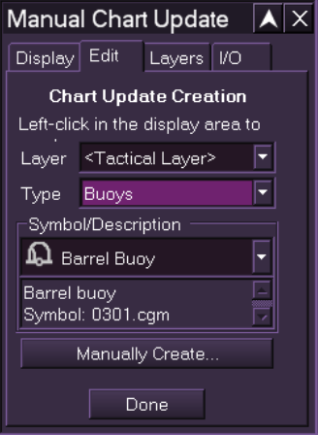
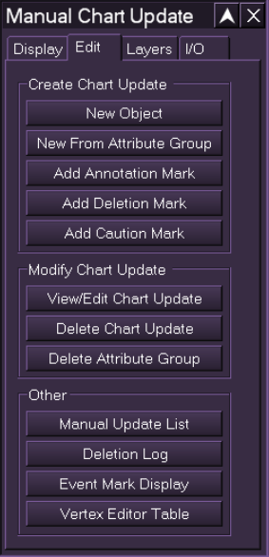
We can offset the chart left, right, up, or down by clicking near the edge of the chart display (the cursor will change into an arrow).
To center the chart on a specific position, select “Goto” on the lower toolbar to open the “Goto” pop-up window.
Enter desired latitude and longitude and select “Go” to offset the chart display on the position.
Enter the following coordinates:
Lat: 32°40’000” N
Lon: 117°14’000”W
What area is your chart now centered on?
Edit a Layer
The navigator will choose objects and features in the area to serve as navigation aids.
The list of navigation aids is called a Gazetteer
Refer to Coast Pilot or Sailing Directions for commonly used navigation aids
Input Navigation Aids
Select “Edit” tab in Manual Chart Update pop-up window → Select “New Object”
Select desired layer in drop-down “Layer” menu (your layer)
Select object category in the drop-down “Type” menu
Select the appropriate symbol in the drop-down “Symbol/description” menu
Select “Manually Create”
(Continued next slide)
SEANAV I United States Naval Academy
NN220 – Fundamentals of Navigation
Operations Officer I HMS PROTECTOR A173 I The Ice Patrol Ship

Slide 38


We can offset the chart left, right, up, or down by clicking near the edge of the chart display (the cursor will change into an arrow).
To center the chart on a specific position, select “Goto” on the lower toolbar to open the “Goto” pop-up window.
Enter desired latitude and longitude and select “Go” to offset the chart display on the position.
Enter the following coordinates:
Lat: 32°40’000” N
Lon: 117°14’000”W
What area is your chart now centered on?
Edit a Layer
Manually Create
The pop-up window will refresh with more options for us to fill out.
We have already filled out “Layer,” “Type,” and “Symbol/Description.”
Enter desired position for the object and any notes and labels associated with the object in the appropriate tabs.
Name the object (in accordance with your gazetteer)
NTM
If an object is added/ updated in response to a Notice to Mariners, selecting the “Advanced” button will allow us to properly associate the NTM by week and year.
Select “Done” to add the object to your layer.
SEANAV I United States Naval Academy
NN220 – Fundamentals of Navigation
Operations Officer I HMS PROTECTOR A173 I The Ice Patrol Ship

Slide 39
We can offset the chart left, right, up, or down by clicking near the edge of the chart display (the cursor will change into an arrow).
To center the chart on a specific position, select “Goto” on the lower toolbar to open the “Goto” pop-up window.
Enter desired latitude and longitude and select “Go” to offset the chart display on the position.
Enter the following coordinates:
Lat: 32°40’000” N
Lon: 117°14’000”W
What area is your chart now centered on?
Example
Layer Name: NN220x_Last Name
Gazetteer:
VA: 32° 41’ 31” N
Tower 117° 15’ 04” W
VB 32° 42’ 05” N
Tower 117° 12’ 28” W
RA 32° 41’ 57” N
Pier 117° 14’ 15” W
RB 32° 39’ 53” N
Pt Loma 117° 14’ 33” W
SEANAV I United States Naval Academy
NN220 – Fundamentals of Navigation
Operations Officer I HMS PROTECTOR A173 I The Ice Patrol Ship

Slide 40



We can offset the chart left, right, up, or down by clicking near the edge of the chart display (the cursor will change into an arrow).
To center the chart on a specific position, select “Goto” on the lower toolbar to open the “Goto” pop-up window.
Enter desired latitude and longitude and select “Go” to offset the chart display on the position.
Enter the following coordinates:
Lat: 32°40’000” N
Lon: 117°14’000”W
What area is your chart now centered on?
Create a Route
We create a route to consolidate the track, establish turn bearings and ranges, set reminders for significant events, and monitor dangers along our track.
Once the CO approves a route, the navigation team monitors it continuously throughout a transit.
To create a new route:
“Show Menu” → “Routes” → “Edit Route”
In the pop-up window, select the “Route” tab
Select “Clear/New” → “Save As”
Type in desired route name → “OK”
Create a route and name it “NN310_Lastname”
We can set the “ETD.”
“Total Distance and Duration” and “ETA” are calculated based on the waypoint information
SEANAV I United States Naval Academy
NN220 – Fundamentals of Navigation
Operations Officer I HMS PROTECTOR A173 I The Ice Patrol Ship

Slide 41

We can offset the chart left, right, up, or down by clicking near the edge of the chart display (the cursor will change into an arrow).
To center the chart on a specific position, select “Goto” on the lower toolbar to open the “Goto” pop-up window.
Enter desired latitude and longitude and select “Go” to offset the chart display on the position.
Enter the following coordinates:
Lat: 32°40’000” N
Lon: 117°14’000”W
What area is your chart now centered on?
Create Waypoints
To create Waypoints for a route:
Select “Wpts” tab in Edit Route pop-up window
Select “New”
Type in desired latitude and longitude
Fill in desired speed, off track limit, and rudder angle for approaching leg, turn, and departing leg in accordance with track data sheet
Select “New” to continue with next WP.
The next WP will always initially appear directly on top of the proceeding WP.
Repeat steps as necessary.
Once all WPs have been created, select “Save”
SEANAV I United States Naval Academy
NN220 – Fundamentals of Navigation
Operations Officer I HMS PROTECTOR A173 I The Ice Patrol Ship

Slide 42


We can offset the chart left, right, up, or down by clicking near the edge of the chart display (the cursor will change into an arrow).
To center the chart on a specific position, select “Goto” on the lower toolbar to open the “Goto” pop-up window.
Enter desired latitude and longitude and select “Go” to offset the chart display on the position.
Enter the following coordinates:
Lat: 32°40’000” N
Lon: 117°14’000”W
What area is your chart now centered on?
Create Route Features
Turn Bearings and Ranges
Select “Features” tab in Edit Route pop-up window and select desired waypoint
Ex. Turn Bearing on leg 3-4 will be taken at WP4
Select the turn icon
Fill in information for desired turn bearing/range object.
Right-clicking in the position field and select “Query” to choose turn objects on your display.
Verify correct object in pop-up window and select appropriate aid and select “OK”
Type in desired name and select “New” once you are finished.
Select “Save” after all turn bearings and ranges are entered.
SEANAV I United States Naval Academy
NN220 – Fundamentals of Navigation
Operations Officer I HMS PROTECTOR A173 I The Ice Patrol Ship

Slide 43

We can offset the chart left, right, up, or down by clicking near the edge of the chart display (the cursor will change into an arrow).
To center the chart on a specific position, select “Goto” on the lower toolbar to open the “Goto” pop-up window.
Enter desired latitude and longitude and select “Go” to offset the chart display on the position.
Enter the following coordinates:
Lat: 32°40’000” N
Lon: 117°14’000”W
What area is your chart now centered on?
Example
Route Name: NN220x_Lastname
Track Data Sheet
SEANAV I United States Naval Academy
NN220 – Fundamentals of Navigation
Operations Officer I HMS PROTECTOR A173 I The Ice Patrol Ship

Slide 44
We can offset the chart left, right, up, or down by clicking near the edge of the chart display (the cursor will change into an arrow).
To center the chart on a specific position, select “Goto” on the lower toolbar to open the “Goto” pop-up window.
Enter desired latitude and longitude and select “Go” to offset the chart display on the position.
Enter the following coordinates:
Lat: 32°40’000” N
Lon: 117°14’000”W
What area is your chart now centered on?
Creating a Great Circle Route
-VMS gives us the ability to plot a Great Circle route over long distances to show the shortest distance between two points on a sphere.
-This is useful in trans-oceanic voyages.
-However, a Great Circle route is impractical to navigate.
-What is the solution?
SEANAV I United States Naval Academy
NN220 – Fundamentals of Navigation
Operations Officer I HMS PROTECTOR A173 I The Ice Patrol Ship

Slide 45


Slide 46


Slide 47

Divide route into legs, no more than 350-400 NM each.
Change each of the legs from GCs to RLs.

Slide 48
160◦
155◦
150◦
145◦
140◦
135◦
130◦
125◦
120◦
50◦
Essentially, you’ve broken up a Great Circle track into smaller legs using Rhumb Lines to form a Composite Track.
This allows for steadying courses, while still driving the shortest distance.
45◦
40◦
35◦
Composite Track 2270 NM
30◦
Rhumb Line 2280 NM
25◦
20◦

Slide 49

We can offset the chart left, right, up, or down by clicking near the edge of the chart display (the cursor will change into an arrow).
To center the chart on a specific position, select “Goto” on the lower toolbar to open the “Goto” pop-up window.
Enter desired latitude and longitude and select “Go” to offset the chart display on the position.
Enter the following coordinates:
Lat: 32°40’000” N
Lon: 117°14’000”W
What area is your chart now centered on?
Critical Points
Critical Points (CP) are special events along a route that require those on watch to take action. The navigator creates CPs based on proximity (time or distance), and will generate an alarm or warning at the proximity. Examples include:
Crossing the Line of Demarcation
Pilot Pick-up
Station Sea and Anchor Detail
SEANAV I United States Naval Academy
NN220 – Fundamentals of Navigation
Operations Officer I HMS PROTECTOR A173 I The Ice Patrol Ship

Slide 50
We can offset the chart left, right, up, or down by clicking near the edge of the chart display (the cursor will change into an arrow).
To center the chart on a specific position, select “Goto” on the lower toolbar to open the “Goto” pop-up window.
Enter desired latitude and longitude and select “Go” to offset the chart display on the position.
Enter the following coordinates:
Lat: 32°40’000” N
Lon: 117°14’000”W
What area is your chart now centered on?
Critical Points
To create CPs:
Select “CP” tab in “Edit Route” pop-up window
Select “New”
Type in desired latitude and longitude of critical point
Select appropriate Alert Type and enter desired proximity
Type in desired Description prompt
Repeat steps as necessary.
Select “Save”
SEANAV I United States Naval Academy
NN220 – Fundamentals of Navigation
Operations Officer I HMS PROTECTOR A173 I The Ice Patrol Ship

Slide 51
We can offset the chart left, right, up, or down by clicking near the edge of the chart display (the cursor will change into an arrow).
To center the chart on a specific position, select “Goto” on the lower toolbar to open the “Goto” pop-up window.
Enter desired latitude and longitude and select “Go” to offset the chart display on the position.
Enter the following coordinates:
Lat: 32°40’000” N
Lon: 117°14’000”W
What area is your chart now centered on?
Route Dangers
VMS identifies dangers and cautions along a planned route.
Select “Dngrs” tab in Edit Route pop-up window
Select desired leg
Select scale (recommend largest scale available)
If there are too many dangers to process
Check your route! You may be going through shoal water or over land!
SEANAV I United States Naval Academy
NN220 – Fundamentals of Navigation
Operations Officer I HMS PROTECTOR A173 I The Ice Patrol Ship

Slide 52

We can offset the chart left, right, up, or down by clicking near the edge of the chart display (the cursor will change into an arrow).
To center the chart on a specific position, select “Goto” on the lower toolbar to open the “Goto” pop-up window.
Enter desired latitude and longitude and select “Go” to offset the chart display on the position.
Enter the following coordinates:
Lat: 32°40’000” N
Lon: 117°14’000”W
What area is your chart now centered on?
Route Monitoring
Once our route is created and saved, we can monitor the route for real-time information
To monitor your route:
“Show Menu” → “Routes” → “Monitor Route”
Load your route and the window will provide information such as:
Bearing (course)
Distance and time to turn
Information on the following course
Cross-track error
Turn bearing information
And many more functions
SEANAV I United States Naval Academy
NN220 – Fundamentals of Navigation
Operations Officer I HMS PROTECTOR A173 I The Ice Patrol Ship

Slide 53

We can offset the chart left, right, up, or down by clicking near the edge of the chart display (the cursor will change into an arrow).
To center the chart on a specific position, select “Goto” on the lower toolbar to open the “Goto” pop-up window.
Enter desired latitude and longitude and select “Go” to offset the chart display on the position.
Enter the following coordinates:
Lat: 32°40’000” N
Lon: 117°14’000”W
What area is your chart now centered on?
Anchoring
To input an anchorage area.
“Show Menu” → “Nav Tools” → “Anchoring”
Select “Planning” tab in Anchoring pop-up window.
Type in desired latitude and longitude of anchor position or select “On Chart”
Selecting “On Chart” will change the cursor to select location display. Click on the display at desired area to set the location.
Select “On Chart” button for Head brg and click desired aid
Type in desired latitude and longitude for appropriate aids under Drop Objects range and bearing or select “On Chart”
On chart zoom in at anchorage position.
Record nearest charted depth and type in at Anchor Depth.
Select desired Anchor Scope of chain.
SEANAV I United States Naval Academy
NN220 – Fundamentals of Navigation
Operations Officer I HMS PROTECTOR A173 I The Ice Patrol Ship

Slide 54
We can offset the chart left, right, up, or down by clicking near the edge of the chart display (the cursor will change into an arrow).
To center the chart on a specific position, select “Goto” on the lower toolbar to open the “Goto” pop-up window.
Enter desired latitude and longitude and select “Go” to offset the chart display on the position.
Enter the following coordinates:
Lat: 32°40’000” N
Lon: 117°14’000”W
What area is your chart now centered on?
Example
Anchorage
32° 43′ 06“ N
117° 11′ 00“ W
Head Bearing
VB
Drop Bearing
RB
Drop Range
RB
Amount of Chain 5x
SEANAV I United States Naval Academy
NN220 – Fundamentals of Navigation
Operations Officer I HMS PROTECTOR A173 I The Ice Patrol Ship

Slide 55

We can offset the chart left, right, up, or down by clicking near the edge of the chart display (the cursor will change into an arrow).
To center the chart on a specific position, select “Goto” on the lower toolbar to open the “Goto” pop-up window.
Enter desired latitude and longitude and select “Go” to offset the chart display on the position.
Enter the following coordinates:
Lat: 32°40’000” N
Lon: 117°14’000”W
What area is your chart now centered on?
Anchoring
How to monitor your anchorage
Select “Status” tab in Anchoring pop-up window.
Select “Anchoring Feature On.”
Values for drop bearing and drop range are found in “Reference Drop Objects.”
Once ship is ready, selecting “Drop Anchor” will initiate the process in VMS.
NAVDORM:
SEANAV I United States Naval Academy
NN220 – Fundamentals of Navigation
Operations Officer I HMS PROTECTOR A173 I The Ice Patrol Ship

Slide 56
We can offset the chart left, right, up, or down by clicking near the edge of the chart display (the cursor will change into an arrow).
To center the chart on a specific position, select “Goto” on the lower toolbar to open the “Goto” pop-up window.
Enter desired latitude and longitude and select “Go” to offset the chart display on the position.
Enter the following coordinates:
Lat: 32°40’000” N
Lon: 117°14’000”W
What area is your chart now centered on?
VMS Drag and Swing Circle
Drag/Swing circles smaller than what normally plotted on paper chart due to scope or catenary on the chain
Alarm as ship approaches edge of drag circle
VMS “Anchor chain”
Actual Anchor chain
SEANAV I United States Naval Academy
NN220 – Fundamentals of Navigation
Operations Officer I HMS PROTECTOR A173 I The Ice Patrol Ship

Slide 57
We can offset the chart left, right, up, or down by clicking near the edge of the chart display (the cursor will change into an arrow).
To center the chart on a specific position, select “Goto” on the lower toolbar to open the “Goto” pop-up window.
Enter desired latitude and longitude and select “Go” to offset the chart display on the position.
Enter the following coordinates:
Lat: 32°40’000” N
Lon: 117°14’000”W
What area is your chart now centered on?
Navigation Plan
To create a new navigation plan
“Show Menu” → “Nav Plans” → “View/Edit Nav Plan”
In “NP” tab select “Modify” button at bottom of the “View/Edit Nav Plan” pop-up window.
Select “Create” button.
Type in NN310_Lastname and select “Okay”
To associate your route, layer, and charts
In “Rte/PIM” tab select “Insert” button.
Select desired route.
Repeat steps in “Lyr” and “Cht” tabs.
Must select all four DNCs in “Cht” tab.
Save NavPlan
SEANAV I United States Naval Academy
NN220 – Fundamentals of Navigation
Operations Officer I HMS PROTECTOR A173 I The Ice Patrol Ship

Slide 58
We can offset the chart left, right, up, or down by clicking near the edge of the chart display (the cursor will change into an arrow).
To center the chart on a specific position, select “Goto” on the lower toolbar to open the “Goto” pop-up window.
Enter desired latitude and longitude and select “Go” to offset the chart display on the position.
Enter the following coordinates:
Lat: 32°40’000” N
Lon: 117°14’000”W
What area is your chart now centered on?
Example
Navigation Plan Name: NN220x_Lastname
Layer: NN220x_Lastname
Route: NN220x_Lastname
Charts: H1316010
A1316010
COA13B
GEN13A
SEANAV I United States Naval Academy
NN220 – Fundamentals of Navigation
Operations Officer I HMS PROTECTOR A173 I The Ice Patrol Ship

Slide 59
We can offset the chart left, right, up, or down by clicking near the edge of the chart display (the cursor will change into an arrow).
To center the chart on a specific position, select “Goto” on the lower toolbar to open the “Goto” pop-up window.
Enter desired latitude and longitude and select “Go” to offset the chart display on the position.
Enter the following coordinates:
Lat: 32°40’000” N
Lon: 117°14’000”W
What area is your chart now centered on?
VMS Piloting
“Goto” the following location
Lat: 32°40’000” N
Lon: 117°14’000”W
Display your layer
Open the menu that allows you to select the sensor for ship’s position (remember how?)
Select “Man” for sensor
Manually input ship position
32°42’00”N
117°13’55”W
SEANAV I United States Naval Academy
NN220 – Fundamentals of Navigation
Operations Officer I HMS PROTECTOR A173 I The Ice Patrol Ship

Slide 60

We can offset the chart left, right, up, or down by clicking near the edge of the chart display (the cursor will change into an arrow).
To center the chart on a specific position, select “Goto” on the lower toolbar to open the “Goto” pop-up window.
Enter desired latitude and longitude and select “Go” to offset the chart display on the position.
Enter the following coordinates:
Lat: 32°40’000” N
Lon: 117°14’000”W
What area is your chart now centered on?
Selecting NAVAIDs
Open “Line of Position” pop-up window
“Show Menu” → “NavTools” → “Line of Position”
Select the “Local Navaids” tab to begin an automatic chart query of available NAVAIDs
Select which NAVAIDs you want to use for your fix by clicking the check box next to each available NAVAID
Select “Activate Selected LOPs”
SEANAV I United States Naval Academy
NN220 – Fundamentals of Navigation
Operations Officer I HMS PROTECTOR A173 I The Ice Patrol Ship

Slide 61
We can offset the chart left, right, up, or down by clicking near the edge of the chart display (the cursor will change into an arrow).
To center the chart on a specific position, select “Goto” on the lower toolbar to open the “Goto” pop-up window.
Enter desired latitude and longitude and select “Go” to offset the chart display on the position.
Enter the following coordinates:
Lat: 32°40’000” N
Lon: 117°14’000”W
What area is your chart now centered on?
Creating a Line of Position
All selected NAVAIDs will populate under the LOP tab
Manually
Select “Manual” from the drop-down menu next to desired NAVAID
Enter manual bearing/ range
Automatically
Select “Predicted” from the drop-down menu next to desired NAVAID
The system automacially fills in bearing/ range
SEANAV I United States Naval Academy
NN220 – Fundamentals of Navigation
Operations Officer I HMS PROTECTOR A173 I The Ice Patrol Ship

Slide 62
We can offset the chart left, right, up, or down by clicking near the edge of the chart display (the cursor will change into an arrow).
To center the chart on a specific position, select “Goto” on the lower toolbar to open the “Goto” pop-up window.
Enter desired latitude and longitude and select “Go” to offset the chart display on the position.
Enter the following coordinates:
Lat: 32°40’000” N
Lon: 117°14’000”W
What area is your chart now centered on?
Calculating a Fix
Click the “Calc Fix” button on the bottom of the LOP menu
Enter in quality of fix based on “Difference” box.
Difference display shows the difference between the calculated LOP position and the active sensor value.
Accept fix to display the fix on your chart
Reject the fix to reset the LOP menu
SEANAV I United States Naval Academy
NN220 – Fundamentals of Navigation
Operations Officer I HMS PROTECTOR A173 I The Ice Patrol Ship

Slide 63
We can offset the chart left, right, up, or down by clicking near the edge of the chart display (the cursor will change into an arrow).
To center the chart on a specific position, select “Goto” on the lower toolbar to open the “Goto” pop-up window.
Enter desired latitude and longitude and select “Go” to offset the chart display on the position.
Enter the following coordinates:
Lat: 32°40’000” N
Lon: 117°14’000”W
What area is your chart now centered on?
Route Monitoring
To monitor your route:
“Show Menu” → “Routes” → “Monitor Route” → “Load Route” → Select your route.
Input manual COG, Heading, and SOG to view how the values change.
SEANAV I United States Naval Academy
NN220 – Fundamentals of Navigation
Operations Officer I HMS PROTECTOR A173 I The Ice Patrol Ship

Slide 64
Enabling Objectives
1 - UNDERSTAND the Display and Basic Functions of VMS. a. Sensors data and display (SOG, STW, HDG, COG, MOB etc.) 2 - UNDERSTAND the sensor sources and identify valid and invalid sensors. 3 - UNDERSTAND all toolbars and Main Menu options. 4 - UNDERSTAND and set up all Feature Settings IAW SEANAV Navigation Standards. 5 - USE GoTo to move to different locations on VMS. 6 - IDENTIFY and load a chart, and understand chart scales. 7 - UNDERSTAND anchoring procedures and considerations. 8 - UNDERSTAND Critical Points, how to input them, and when they should be utilized. 9 - IDENTIFY Chart categories used in VMS and know how to read a DNC name. 10 - OPERATE Various Navigation Tools. a. Perform Man-Overboard Procedures b. Lines of Position c. Anchoring
SEANAV I United States Naval Academy
NN220 – Fundamentals of Navigation
Operations Officer I HMS PROTECTOR A173 I The Ice Patrol Ship

Slide 65
Enabling Objectives
11 - OPERATE appropriate settings in the Safety Configuration Menu. 12 - USE Query Chart function. 13 - USE chart menu to create a new layer. 14 - ESTABLISH visual and RADAR NAVAIDS by creating a Layer under Manual Chart Update. 15 - USE the Route Editor to create, and save a Route Plan/NAV Plan. Enter Critical Points to coincide with Required Actions/Reports 16 - MAKE chart corrections to a digital nautical chart (DNC). 17 - EXPLAIN & Identify the Cross Track Error. 18 - LOAD a Route Plan. 19 - CREATE, save, load, start, stop and clear a Navigation Plan. 20 - UNDERSTAND the functions of Route Monitoring.
SEANAV I United States Naval Academy
NN220 – Fundamentals of Navigation
Operations Officer I HMS PROTECTOR A173 I The Ice Patrol Ship

Slide 66


Questions?
SEANAV I United States Naval Academy
NN220 – Fundamentals of Navigation
Operations Officer I HMS PROTECTOR A173 I The Ice Patrol Ship

